Slide 1
The Dweller Left Adrift
No main menu image yet ☹
Made by: James K. Philip D. Vinh M.

Slide 2
About the project
The game has a Metroidvania style. (In which involves a huge map with your screen scrolling).
It Includes a lot of mechanics (gravity, jump, dash, attack etc.)
It has Pixel Art style.
It has 3 Levels, the First Level is a Tutorial, the second and third levels are normal gameplay.

Slide 3
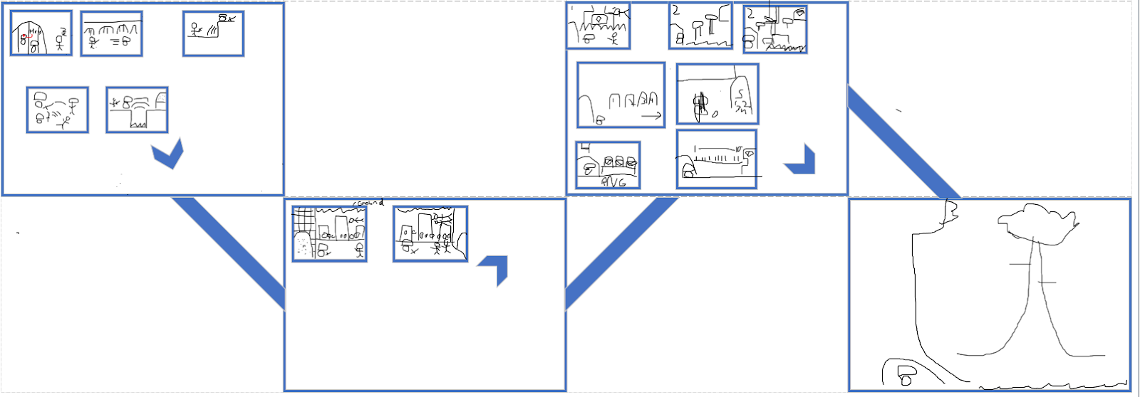
Map Layout

Slide 4
Roles and Achievements
James K. -Group manager, GDD, World Designer, Text Dialogue, Programmer,
Philip D. -GDD, Level Designer, Some Pixel Art, Menus, Programmer,
Vinh M. -Head Programmer, Develop many mechanics,

Slide 5
Demonstration
In class

Slide 6
Interesting codes
Jumping on and off a platform.
Platform collisions
Scrolling world.
Text Dialogue.
Menus mechanic.

Slide 7
What is next?
Add the characters/level/Menu Pixel Art design.
Introduce Attacks: light attacks and heavy attacks, with a cooldown for heavy.
Introduce Enemies AI to make them move and/or attack depending on the player`s location
Due to time, we might only do 1 to 2 Levels.(Tutorial and Ants` City).
Add sounds to the characters and world level depending on the action(character) / world (level).

Slide 8
Problems and issues?
It is the almost the end of the semester, other courses assignments makes us have less time to work on the game.
We took over a day to figure the code thaty allows the main character to stay on top of the platform and not make it go through.

